Slide 1
Wakefield HOA
Annual Meeting - February 18, 2020

Slide 2
Questions:
-Feel free to raise your hand and ask along the way.
-Please wait until Karen has finished all of budget slides before asking money questions.
Thanks!

Slide 3
Current Board Members
Steve
Kim Duffie - President
Steve Pappas - Vice President
Karen Ross - Treasurer
Paul Liguori - Member-At-Large
Rob Souchon - Member-At-Large
Dave Ward - Member-at-large (Moving soon)
3 Open positions + Dave’s spot

Slide 4
Management Co. Responsibilities Ken
Welcome to the new owner of Meridian Management powered by
PMI Property Management
Kenith and Jessica Britt
Introduce himself

Slide 5
Management Co. Responsibilities (ctd) Phil
PMI/Meridian Mgt./Phil - Welcome to Phil Freeman! PMI is the new owner.
Keep track of all contracts for vendors (lawn care, ponds, irrigation)
Communicate with vendors for maintenance and repairs
Pay all bills and manage all invoices
Send notices and collect Annual Meeting info and Annual dues
Work with treasurer to create Annual Budget
Collect Architectural requests, submit to committee, send approval
Send out covenant violation letters per the rules of the Covenants and Rules and Regulations documents
Send to and handle all matters at the Attorney’s office

Slide 6
Board Responsibilities Kim
President- Kim
Lead all meetings
Manage the website www.cgwakefield.com
Head administrator for the FB group and manage HOA e-mail
Communicate with leaders in West and Sec 3.
Communicate with Denison Properties about empty land on corner of Smith Valley Rd and Morgantown Rd, privacy fence behind Sutton Drive, wall at Bancroft entrance and ponds near VCA and Goddard.
Manage communications with Otto’s Streetscapes about mailboxes
Day-to-day communications with Nick’s Lawn Care on small issues

Slide 7
Board Responsibilities Steve
Vice-President-Steve
Communicate with Johnson Co. and State of IN Homeland Security
Attend meetings and keep up to date on I-69 project
Head of Architectural Committee
Secretary-Dave
Keep record of all meeting minutes
Time keeper for all meetings
Welcome basket delivery

Slide 8
Board Responsibilities Karen & Rob
Treasurer- Karen
Double check monthly bank statements, all invoices, payments (This is A LOT of work and she does a great job.)
Problem solve with Meridian on any discrepancies or problems with bills
Work with Meridian to create Annual Budget
At-Large- Rob
Manage all negotiations on contracts with Nick’s Lawn Care
Manage bids for all landscape work in the Common Areas
Advise board on all landscape issues

Slide 9
Propose a Project Paul
We always welcome homeowners doing research and presenting proposals to the Board at any meeting. (We appreciate the help!! It’s a lot of work to do on our own.)
Examples from the past:
Reflective numbers on mailboxes for emergency crews
Trash cans at the park, New signs
Geese/pond issues
Landscape suggestions- Homeowner, Laura Minzes, put together tree and shrub replacement guidelines. Link to website coming soon!
We’ve contacted all 4 trash companies and none of them are willing to work with us on “Neighborhood Pricing”
What other things would you like to see the board improve upon? Open Comments

Slide 10

IMPORTANT “To Do” list for tonight
Phil
Make sure Meridian Mgt. has your updated contact info.
Phone #
Cell #
E-mail
Make sure you provide this for all adults in the home.
Annual Dues were due by February 15, 2020
Late fees will be charged starting on March 1, 2020
This means checks, bank payments, and all online payments clear the bank by Feb 29th or a $25 late fee will be added to your bill.
You can pay online!! E-mail them and they will send you a link to login to your account.
info@pmimeridian.com

Slide 11
2019 Year in Review
Rob
11 homeowners took advantage of the mailbox sale. (2 were board members) This year’s sale will be April 13-17, 2020
Ending 2019 with $11,100 more than last year (not considering outstanding checks)

Slide 12
State of the HOA Report
Karen
Review of 2019 Income / Expenses
Review of 2020 budget
Funds remaining Dec 31, 2019 - $92,312
  Checking balance- $38,109 ($34,800 in 2018)
  Savings- $54,203 ($46,400 in 2018)
Important Information / Reminders:
  Annual Dues can be paid online, send email to Meridian as per note on the invoice.
  Reminder: Homeowners are responsible for the $200 fee that the HOA is charged when a collection effort is filed with the lawyer’s office

Slide 13
Review of 2019 Revenue / Collections
Karen
Dues - $325 for 273 homes - $88,725
  Budget available for expenses - $79,825
HOA Late Fees - $900 (up to June), $3,375 posted in error ** Corrected
Interest on HOA bank accounts - $562
Uncollectible Dues - $1,387 (budget was $2,000)
  Basically these are dues that are not possible to collect, such as legal settlement
Transfer to reserves - $7,200 ($600 per month) budget for future improvement projects and emergency funds
Year end Dues not yet collected 2019 - $4,925 (all over 90 days)
  2019 Association fees, legal collection fees, late fees, and past year balances
  21 homeowners

Slide 14
Review of 2019 Expenses - $58,049 (2018 $73,472)
Karen
Under budget by $21,776
Lawn care - Nick’s - $18,555 ($33,650 contract, $15,105 services received, not billed)
Lawn care non contract - Nick’s - $2,000 ($2,000 under budget)
Management Company - $12,972 (target)
Common Area Maintenance - $2,965 ($3,035 under budget)
Dead Tree removal - $2,475 (no budget item, not included in common area maintenance, although budget covers expense)
Utilities
  Duke $3,852 ($152 over budget)
  Bargersville $3,316 ($37 under budget)

Slide 15
Review of 2019 Expenses - cont
Karen
Insurance Premiums - $3,431 ($131 over budget)
Irrigation - $1,188 ($812 under budget)
Ponds - $2,900 ($300 under budget)
Legal - $3,079 ($1,921 under budget)
Printing/Postage - $746 ($604 under budget)
Remainder - $566 (Community events $331, Audit $235)
Welcome Committee $0 ($500 under budget)

Slide 16
2020 Budget Revenue - $88,725 (same as 2019)
Karen
HOA fees $325 / $88,725 expected income (273 homes) **no change to 2019
  $25 late fee will be assessed March 1
Late fee budget of $300
Bad Debt budget $2,000
  Decisions made to write off debt based on cost to collect - ideally nothing is written off, courts sometimes make decision for us
Reserve Funding budget $7,200, same as 2019
  Funds kept in reserve for future repairs and improvement projects
Available for expenses - $79,825

Slide 17
2020 Budget Expense - $79,825 (same as 2019)
Karen
Lawn Care $38,120* 47.75%
Mgt Fee $12,972** 16.25% * 70% of budget
Utilities $7,300* 9.15% */** 86% of budget
Legal Services $5,000 6.26%
Common Area Maint. $4,193* 5.25%
Insurance $3,300 4.13%
Pond Maint. $3,200* 4.01%
Irrigation $1,600* 2.00%
Postage/Copies $1,350 1.69%
Tree Replacement $1,200* 1.50%
Social/Community $800 1.00%
Welcome. $500 0.63%
Misc Admin $290 0.36% (Audit, Internet, Bank Fee)

Slide 18
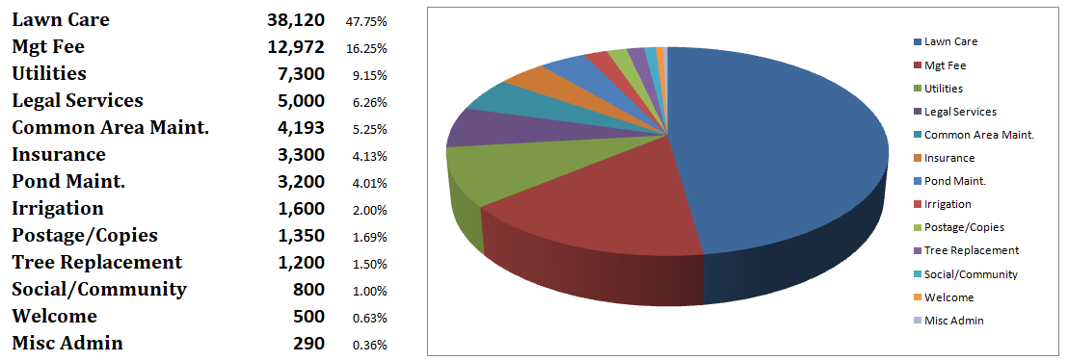
2020 Budget Expense
Karen

Slide 19
2020 Plans for Wakefield
Neighborhood Yard Sale- Thur-Sat. June 18-20 (share large sign price with West and West Sec 3)
Save $ to repair after sewer project finished (Still no updated info from Greenwood Interceptor.)
Emergency fund for aging neighborhood and common area
Purchase new trees for front pond
Neighborhood Picnic- June 27th (tentative)
Mailbox Sale April 13-17
Dave

Slide 20
Architectural Change Request Procedures
Rob
All forms can be found on www.CGWakefield.com under the “Architectural” tab and submitted to Meridian Management via e-mail.
Covenants and Rules and Regulations can be found under the “Governance” tab under “Governance Documents”

Slide 21
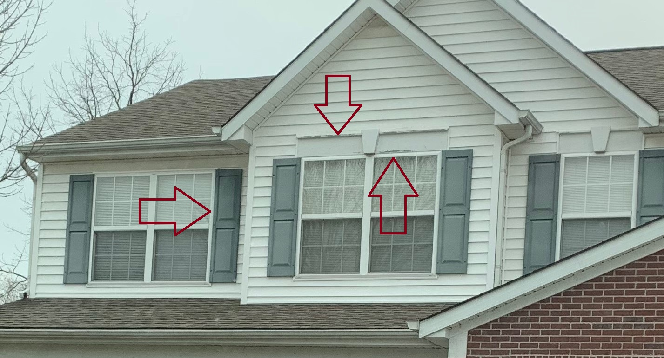
Covenant Violations Steve
Many homes need lots of repairs. Our neighborhood is now 20+ years old, everyone needs to spend some money keeping our homes maintained.
We mentioned several of these at several meetings so the Mgt. Company will be more consistent with violation letters. The Mgt. Company will be referring violations to the HOA attorney by the 3rd letter.
Catch mildew on siding early in the season so that it’s easier to control.
PLEASE treat your lawns for dandelions in early spring.
Recommend yards be mowed every week and string trimmed every 2 weeks (including fence line).
Mailboxes need paint
Mailbox posts need replaced -99 still needed
Window and door trim replacement
Paint trim
Shutters
Landscaping
Trimming weeds
Front flower beds MUST have bushes in them. - 4

Slide 22
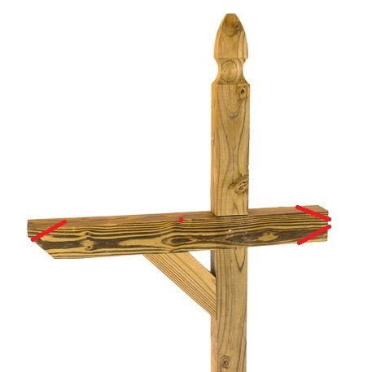
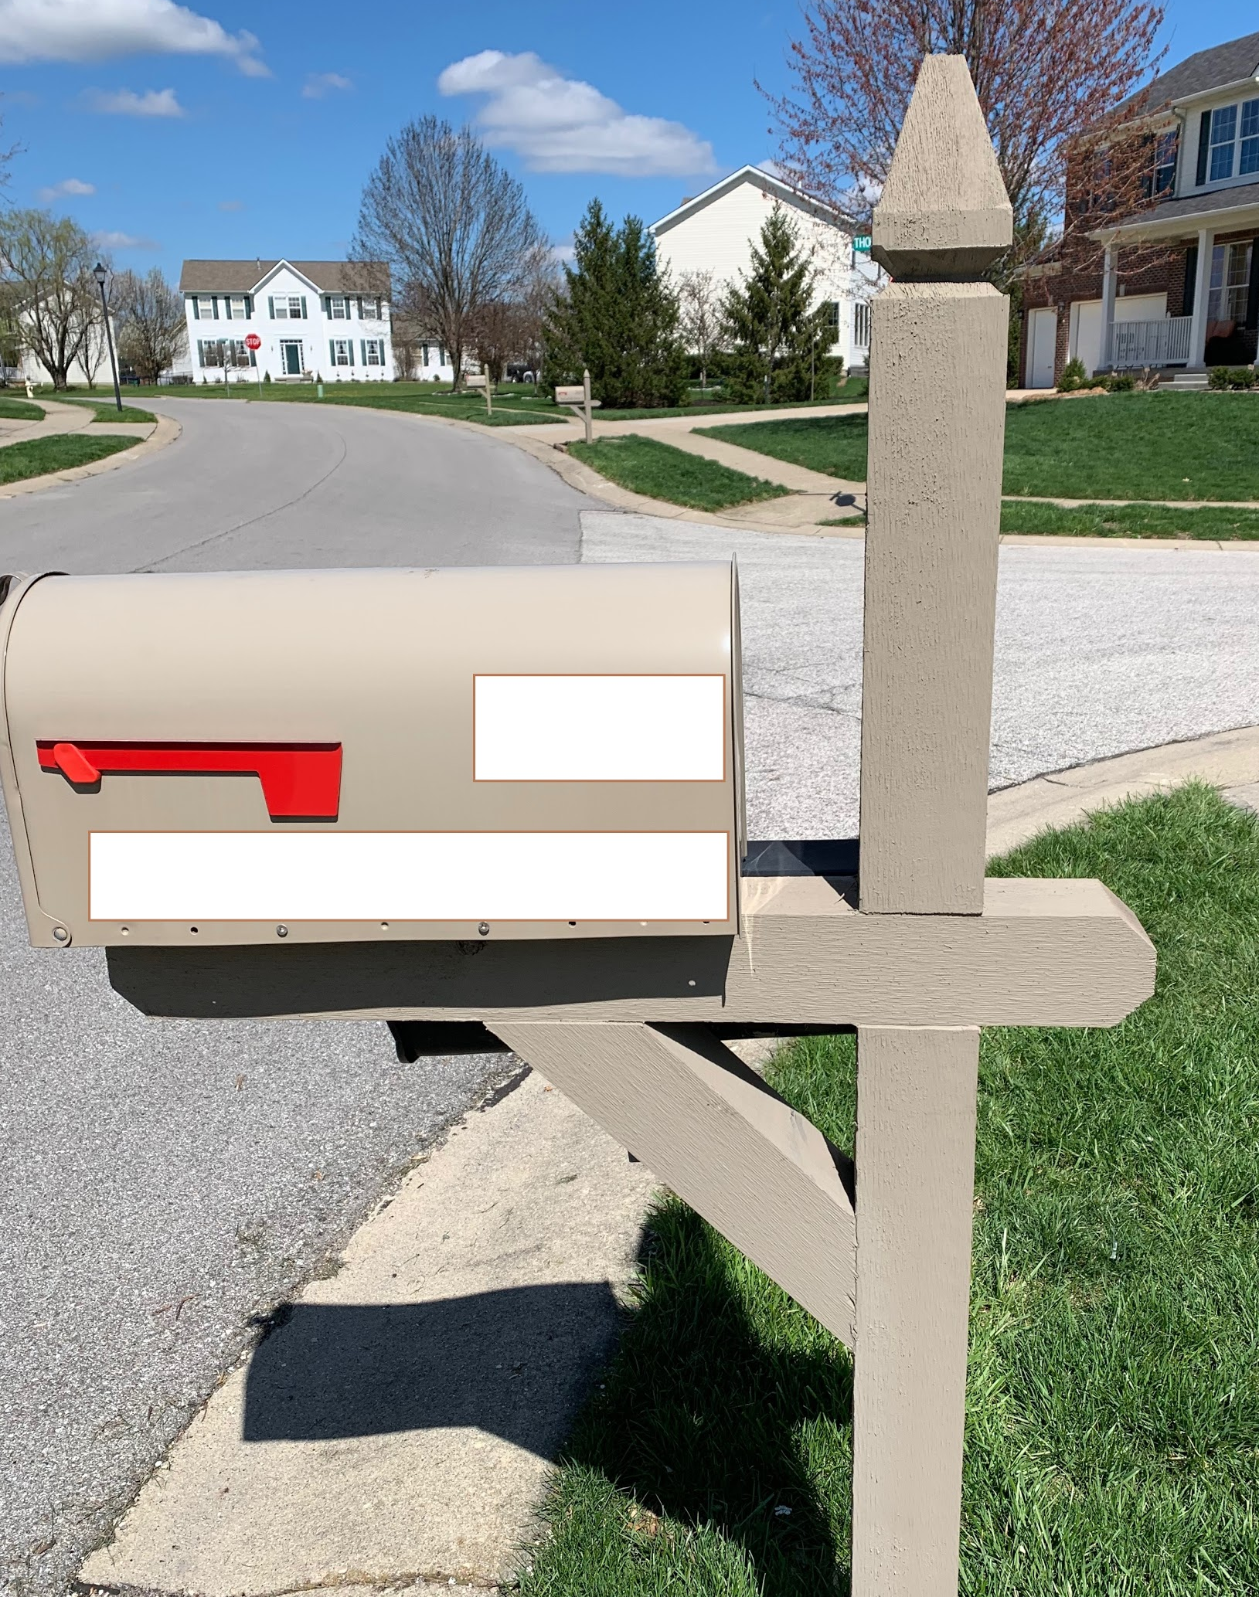
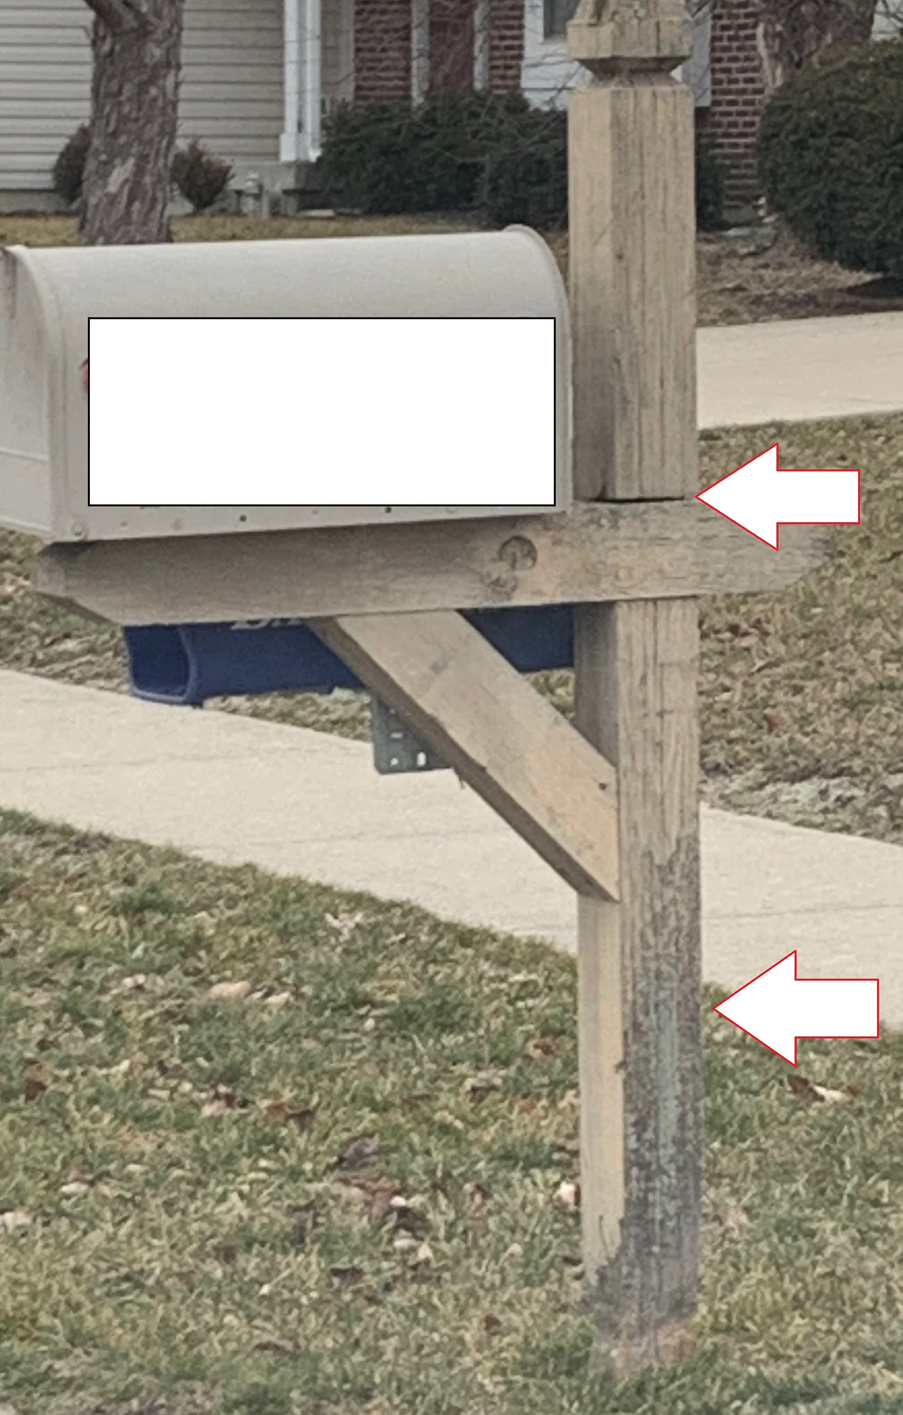
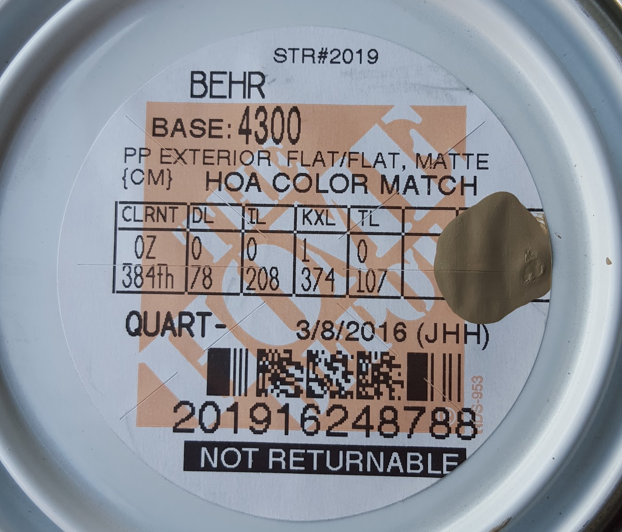
Mailboxes Kim- my “soapbox”
Weather appropriate letters for all violations will start going out on April 1st. This is the 4th summer that we have had a special pricing agreement with Otto’s. Mailbox posts being replaced needs to be a top priority for homeowners this summer. There are still 99 homes that have needed to replace their post for 4 YEARS.
We’re all busy people, but keeping our home maintained needs to be a priority for your family’s safety.
If purchased from Lowe’s, MUST have horizontal ends cut to match.
Purchased and installed by Otto’s.
Seams cracked, wood rotting, must be replaced.
Paint color from Home Depot.

Slide 23
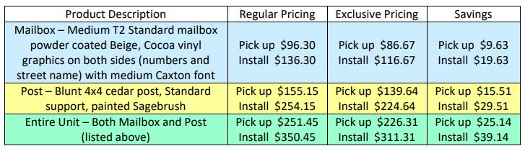
Otto’s Mailboxes Steve
Some mailboxes and posts need to be replaced. Big Box stores do NOT have mailboxes or mailbox posts that match our neighborhood. Otto’s prices are the same, if not cheaper, than what you would pay online. Mailbox post paint color from Home Depot http://cgwakefield.com/mailbox-post-provider/
Otto’s neighborhood discount until Dec 31, 2021. Sale for Wakefield will be the week of April 13-17 at 15% off of the DISCOUNTED price. We will send flyers in the mail. Save up to $56.72 the week of the sale.
April Sale
$81.86
$106.86
$131.88
$211.88
$213.73
$293.73

Slide 24

Home Sales Steve
If you are selling your home, please have your real estate agent prepare a binder with a copy of the following items and place it on your kitchen island during showings:
Covenants
Rules and Regulations
By-Laws
Rental Restriction Amendment
All can be found under the “Governing Documents” on www.cgwakefield.com

Slide 25

Welcoming committee Dave
Thanks to Dave and Colleen for doing such a great job last year!
Help buy supplies, budget provided by the Board
Assemble baskets-Colleen
Need someone to replace
Dave for delivery.

Slide 26
Amendment to Covenants as Proposed by Homeowners
(Paul) Steps to follow:
Covenants pg 20- ARTICLE IX, Sec. 9.1 (ii) 50% of homeowners must propose an amendment (by petition) and present it to the Board
(iii) Lawyer writes up the proposed amendment and holds a “Special Meeting” to discuss proposed amendment (Estimated cost $2,000-$2,500)
3. (v) 18 months to collect ⅔ vote to pass (273 homes = 181 votes of homeowners in good standing)
4. Lawyer files with Johnson County (Estimated cost $1,000)
Total cost for Rental Restriction Amendment was = $3,666

Slide 27

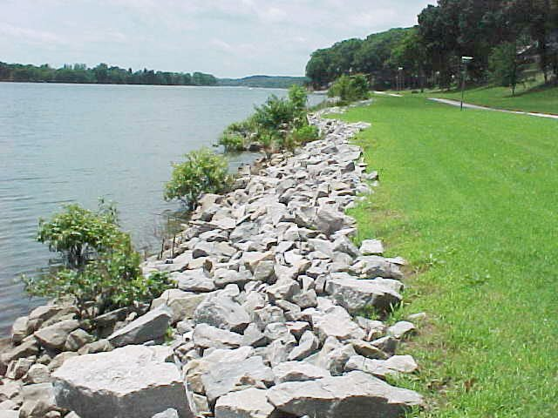

Common Courtesy Items
Please make sure dogs are not barking during quiet hours of 11pm-6am or all day by bringing them inside or using “bark control” collars.
Pick up all dog messes when walking your pet.
Talk to your kids:
  Not to throw the big ‘rip-rap’ rocks into the pond drains.
  NOT to walk on ice on the pond.
  To be respectful of the playground. No climbing on canopy, no big kids in baby swings, no rude language or disrespect towards adults. Hours 7am-10pm
Facebook is the easiest place for us to spread information quickly. The Nextdoor app is not managed by the board. It is fine for general info, but not for Wakefield specific issues.
Kim

Slide 28
Election of New Board Members
Kim
Call for volunteers to run for the board.
One minute speech from each candidate.
Vote
Vote count by Meridian and a volunteer homeowner
Introduction of the new 2020 Board.
Up for Re-election:
Steve Pappas
Rob Souchon
Paul Liguori
4 Open positions

Slide 29
Final Thoughts
When in doubt, ALWAYS call PMI/Meridian Management. Call Phil for covenant violations, neighborhood complaints, architectural change questions, general maintenance, parking an RV or landscape trailer for 2-3 days, etc. 317-262-4989
https://www.pmimeridian.com/
phil@pmimeridian.com
Close the meeting
Steve

