Slide 1
Wakefield HOA
Annual Meeting - February 19, 2019

Slide 2
Current Board Members
Steve
Kim Duffie - President
Steve Pappas - Vice President
Karen Ross - Treasurer
Melanie Piper - Secretary
Rob Souchon - Member-At-Large
Dave Ward - Member-at-large
3 Open positions

Slide 3
Management Co. Responsibilities(Lots of new homeowners in past 2 years) Kim
Meridian Mgt./Valerie
Keep track of all contracts for vendors (lawn care, ponds, irrigation)
Communicate with vendors for maintenance and repairs
Pay all bills and manage all invoices
Send notices and collect Annual Meeting info and Annual dues
Work with treasurer to create Annual Budget
Collect Architectural equests, submit to committee, send approval
Send out covenant violation letters per the rules of the Covenants and Rules and Regulations documents
Send to and handle all matters at the Attorney’s office

Slide 4
Board Responsibilities Kim
President- Kim
Lead all meetings
Manage the website www.cgwakefield.com
Head administrator for the FB group
Manage HOA e-mail
Handle day-to-day issues with items such as AT&T
Communicate with Johnson Co. Highway Dept.
Communicate with Denison Properties about empty land on corner of Smith Valley Rd and Morgantown Rd, privacy fence behind Sutton Drive, wall at Bancroft entrance and ponds near VCA and Goddard.

Slide 5
Board Responsibilities Kim
Secretary-Melanie
Keep record of all meeting minutes
Assistant administrator for the FB group
Manage communications with Otto’s Streetscapes about street signs
Manage communications with playground equipment company
Day-to-day communications with Nick’s Lawn Care on small issues
Vice-President-Steve
Communicate with Johnson Co. and State of IN Homeland Security
Attend meetings and keep up to date on I-69 project
Help with day-to-day issues such as AT&T
Head of Architectural Committee

Slide 6
Board Responsibilities
At-Large- Rob Kim
Manage all negotiations on contracts with Nick’s Lawn Care
Manage bids for all landscape work in the Common Areas
Advise board on all landscape issues
Treasurer- Karen
Double check monthly bank statements, all invoices, payments (This is A LOT of work and she does a great job.)
Problem solve with Meridian on any discrepancies or problems with bills
Work with Meridian to create Annual Budget
At-Large- Dave
Time keeper for board meetings to keep things on track
Helps with FB communications
Welcome basket delivery
Homeowners can also do research and present proposals to the Board at any meeting. Ex: trash removal discounts, common area ideas. Any help from homeowners is greatly appreciated!

Slide 7

IMPORTANT “To Do” list for tonight
Valerie
Make sure Meridian Mgt. has your updated contact info.
Phone #
Cell #
E-mail
Make sure you provide this for all adults in the home.
Annual Dues were due by February 15, 2019
Late fees will be charged starting on March 1, 2019
This means checks, bank payments, and all online payments clear the bank by Feb 28th or a $25 late fee will be added to your bill.
You can pay online!! E-mail them and they will send you a link to login to your account.
Generalmail@meridianmgmtcorp.com

Slide 8
2018 Year in Review
Rob
17 homeowners took advantage of the mailbox sale. This year’s sale will be April 15-21.
Otto’s installed new street signs at the main entrance.
181 violation letters for the year
Approved 10 Architectural Requests
Ending 2018 with $39,000 more than last year ($24,000 uncleared checks ending 2018)

Slide 9
State of the HOA Report
Karen
Review of 2018 Income / Expenses
Review of 2019 budget
Funds remaining Dec 31, 2018 - $57,000 ($24,000 uncashed checks end 2018)
  Checking balance- $34, 828
  Savings- $46,441
Important Information / Reminders:
  Annual Dues can be paid online. If paying by bank transfer there is no fee, pay with credit card there is a fee
  Homeowners are responsible for the $200 fee that the HOA is charged when a collection effort is filed with the lawyer’s office

Slide 10
Review of 2018 Revenue / Collections
Karen
Dues - $325 for 273 homes - $88,725
  Budget available for expenses - $79,825
HOA Late Fees - $1,300 (March - May)
Interest on HOA bank accounts - $311
Uncollectible Dues - $1,035 (April/May) (budget was $2,000)
  Example: court determines we get percentage of what was owed during settlement
Transfer to reserves - $7,200 ($600 per month) budget for future improvement projects and emergency funds
Year end Dues not yet collected 2018 - $6,331 (Majority over 90 days)
  $1,831 2018 Association fees, remainder legal collection fees, late fees, and past year balances
  15 homeowners
  Year end Dues not yet collected 2017 - $5,007

Slide 11
Review of 2018 Expenses - $73,472 (2017 $78,357)
Karen
Lawn care - Nick’s - $38, 965 ($33,650 contract, $4,840 misc, $475 Christmas Decor)
Management Company - $12,972
Common Area Maintenance - $3,629
Utilities
  Duke $3,688
  Bargersville $2,705
Insurance Premiums - $3,131
Irrigation - $2,921
Ponds - $2,342
Legal - $1,275
Printing/Postage - $936
Remainder - $908 (Community events $241, Audit $235, Website $425)

Slide 12
Review of 2018 Income / Expenses
Karen
Expenses under Budget - $6,353
  Legal under $3725
  Common area maintenance under $2,371
  Welcome Committee did not use $500
  Printing Mailing under $589
  Community Events under $559
  Bargersville under $612
  Pond Maintenance under $858
  Irrigation, Lawn care combined over $2,638
Unexpected Expenses for 2018
  Irrigation Repair - $2,127
  Otto’s for selected new signs - $2,725
  Lawn care - more cuts and weeding than expected

Slide 13
2019 Budget Revenue
Karen
HOA fees $325 / $88,725 expected income (273 homes) **no change to 2018
  Due on February 28, 2019, or a $25 late fee will be assessed March 1
Late fee budget of $300
Receipts Jan 2019 - $18,304
Bad Debt budget $2,000
  Decisions made to write off debt based on cost to collect - ideally nothing is written off, courts sometimes make decision for us
Reserve Funding budget $7,200, same as 2018
  Funds kept in reserve for future repairs and improvement projects
Available for expenses - $79,825

Slide 14
2019 Budget Expense - $79,825
Karen
Lawn Care $37,660* 47.2%
Mgt Fee $12,972 16.3% * 72% of budget
Utilities $7,053* 8.8%
Common Area Maint. $6,000* 7.5%
Legal Services $5,000 6.3%
Insurance $3,300 4.1%
Pond Maint. $3,200* 4.0%
Irrigation $2,000* 2.5%
Postage/Copies $1,350 1.7%
Social/Community $500 0.6%
Welcome $500 0.6%
Misc Admin $290 0.4% (Audit, Internet, Bank Fee)

Slide 15
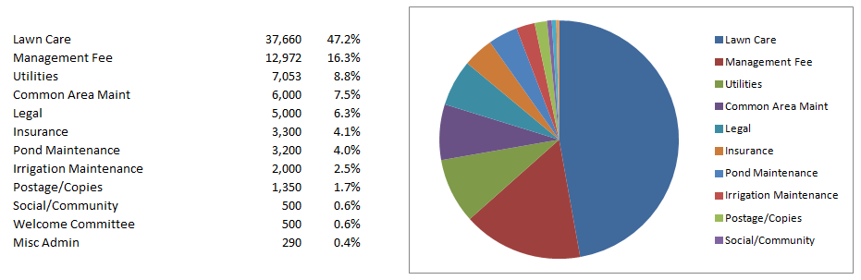
2019 Budget Expense
Karen

Slide 16
2019 Plans for Wakefield
Neighborhood Yard Sale- Thur-Sat. June 13-15 (share large sign price with West and West Sec 3)
Discuss saving $ for lights on walking path and maintenance on rest of path - still waiting on sewer.
Save $ to repair after sewer project finished (Still no info on when sewer project will start.)
Emergency fund for aging neighborhood and common area
Discuss new trees for front pond
Dave

Slide 17

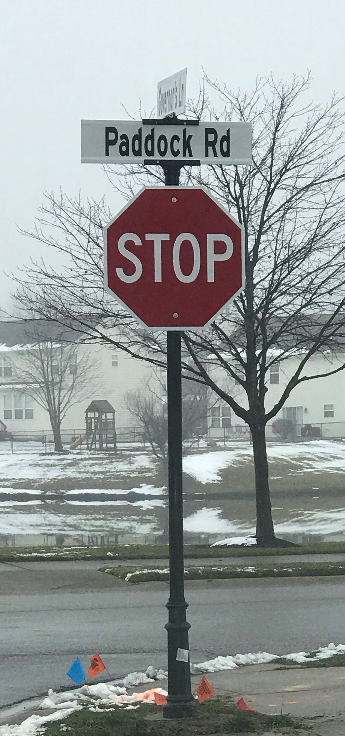
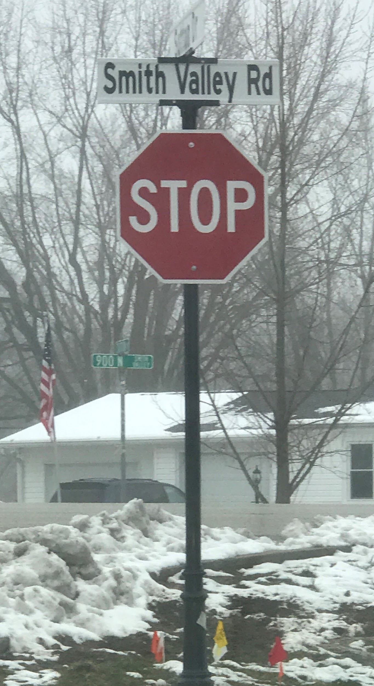
What project would you like to see next?? Rob
Rob -Lights on walking path - Estimate $399 each, 10-15 total =$4,000-$6,000
Update remaining path on the east side after sewer project is complete. Estimate- TBD
Melanie- New Street signs and Stop signs
We did main entrance. Would we like to do
more?
Rob- Main Pond- We need to remove 2 more dead trees. Do we want to replace the trees? What size, etc.

Slide 18
Architectural Change Request Procedures
Rob
All forms can be found on www.CGWakefield.com under the “Architectural” tab and submitted to Meridian Management via e-mail.
Covenants and Rules and Regulations can be found under the “Governance” tab under “Governance Documents”

Slide 19
Covenant Violations Melanie
Many homes need lots of repairs. Our neighborhood is now 20 years old, everyone needs to spend some money keeping our homes maintained.
We mentioned several of these at last year’s meeting so the Mgt. Company will be more consistent with violation letters. The Mgt. Company will be referring violations to the HOA attorney by the 3rd letter.
Catch mildew on siding early in the season so that it’s easier to control.
PLEASE treat your lawns for dandelions in early spring.
Recommend yards be mowed every week and string trimmed every 2 weeks (including fence line).
Mailboxes need paint - 11
Mailbox posts need replaced - 137
Window and door trim replacement - 8
Paint trim - 23
Shutters - 28
Landscaping
Trimming weeds
Front flower beds MUST have bushes in them. - 4

Slide 20
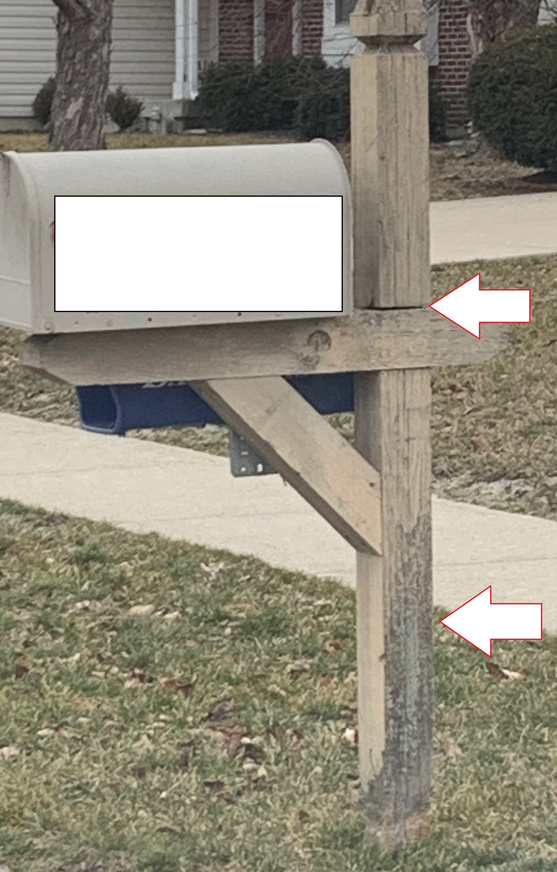
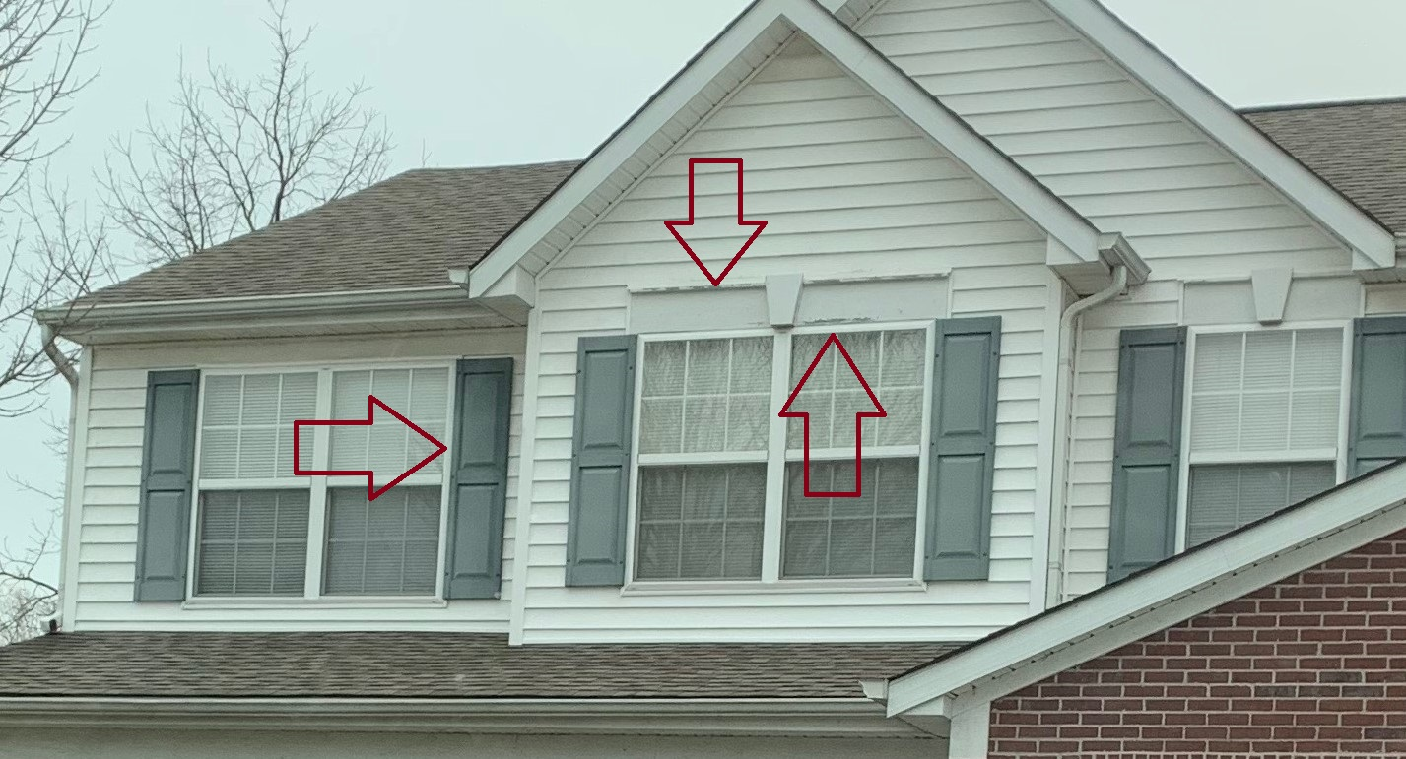
Covenant Violations Melanie
Weather appropriate letters will start going out on April 1st. Examples of items that need to be repaired or replaced:
We’re all busy people, but keeping our home maintained needs to be a priority for your family’s safety.

Slide 21

Home Sales Steve
If you are selling your home, please have your real estate agent prepare a binder with a copy of the following items and place it on your kitchen island during showings:
Covenants
Rules and Regulations
By-Laws
Rental Restriction Amendment
All can be found under the “Governing Documents” on www.cgwakefield.com

Slide 22

Welcoming committee Kim
We only have 1 homeowner helping with Welcome baskets and she had surgery last summer and couldn’t run the committee.
Help buy supplies, budget provided by the Board
Assemble baskets
Board member Dave can deliver. You are welcome to join him.

Slide 23
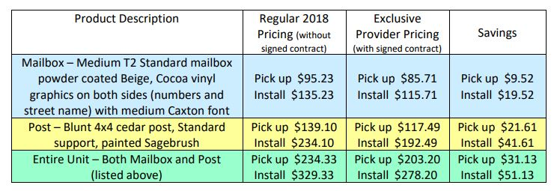
Otto’s Mailboxes Steve
Some mailboxes and posts need to be replaced. Big Box stores do NOT have mailboxes or mailbox posts that match our neighborhood. Otto’s prices are the same, if not cheaper, than what you would pay online. Mailbox post paint color from Home Depot http://cgwakefield.com/mailbox-post-provider/
Otto’s neighborhood discount until Dec 31, 2019. Sale for Wakefield will be the week of April 15-21st at 15% off of- the DISCOUNTED price. We will send flyers in the mail. Save up to $67.43 the week of the sale.
April Sale
$80.95
$105.95
$110.96
$180.96
$191.90
$261.90

Slide 24
Amendment to Covenants as Proposed by Homeowners
Steps to follow:
Covenants pg 20- ARTICLE IX, Sec. 9.1 (ii) 50% of homeowners must propose an amendment (by petition) and present it to the Board
(iii) Lawyer writes up the proposed amendment and holds a “Special Meeting” to discuss proposed amendment (Estimated cost $2,000-$2,500)
3. (v) 18 months to collect ⅔ vote to pass (273 homes = 181 votes of homeowners in good standing)
4. Lawyer files with Johnson County (Estimated cost $1,000)
Total cost for Rental Restriction Amendment was = $3,666
Kim

Slide 25

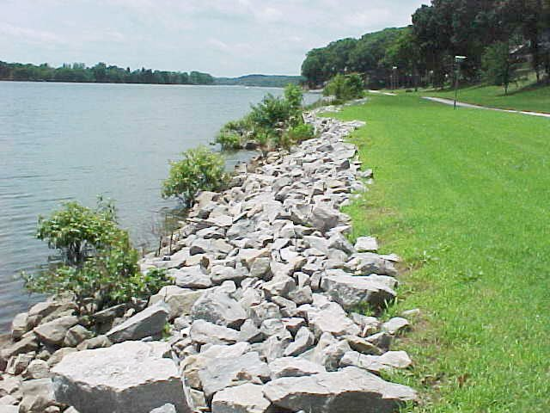

Common Courtesy Items
Please make sure dogs are not barking during quiet hours of 11pm-6am or all day by bringing them inside or using “bark control” collars.
Pick up all dog messes when walking your pet.
Talk to your kids:
  Not to throw the big ‘rip-rap’ rocks into the pond drains.
  NOT to walk on ice on the pond.
  To be respectful of the playground. No climbing on canopy, no big kids in baby swings, no rude language or disrespect towards adults. Hours 7am-10pm
Facebook is the easiest place for us to spread information quickly. The Nextdoor app is not managed by the board. It is fine for general info, but not for Wakefield specific issues.
Kim

Slide 26
Election of New Board Members
Kim
Call for volunteers to run for the board.
One minute speech from each candidate.
Vote
Vote count by Meridian and a volunteer homeowner
Introduction of the new 2019 Board.
Up for Re-election:
Kim Duffie
Melanie Piper
Karen Ross
David Ward
3 Open positions

Slide 27
Final Thoughts
When in doubt, ALWAYS call Meridian Management. Call Valerie for covenant violations, neighborhood complaints, architectural change questions, general maintenance, parking an RV or landscape trailer for 2-3 days, etc. 317-262-4989
www.meridianmgtco.com
vatwell@meridianmgmtcorp.com
Close the meeting
Steve

