Slide 1
Wakefield HOA
Annual Meeting - January 17, 2017

Slide 2
Current Board Members
Kim
Kim Duffie - President
Steve Pappas - Vice President
Karen Ross - Treasurer
Melanie Piper - Secretary
Dave Yount - Member-At-Large
Rob Souchon - Member-At-Large

Slide 3


IMPORTANT “To Do” list for tonight
Kim
Make sure Meridian Mgt. has your updated contact info.
Phone #
Cell #
E-mail
Make sure you provide this for all adults in the home.
Cast your vote for the Rental Restriction amendment.

Slide 4
2016 Year in Review
Rob
Removed 12 dead trees on south side of common area
Planted 2 new trees in entrance island
Privacy Fence panel to hide irrigation pump
Board meetings reduced to every other month -Aug 2016
284 violation letters for the year
Approved 24 Architectural Requests
Ending 2016 with $1,300 more than last year
Annual HOA dues letter mailed earlier to allow more time to pay

Slide 5
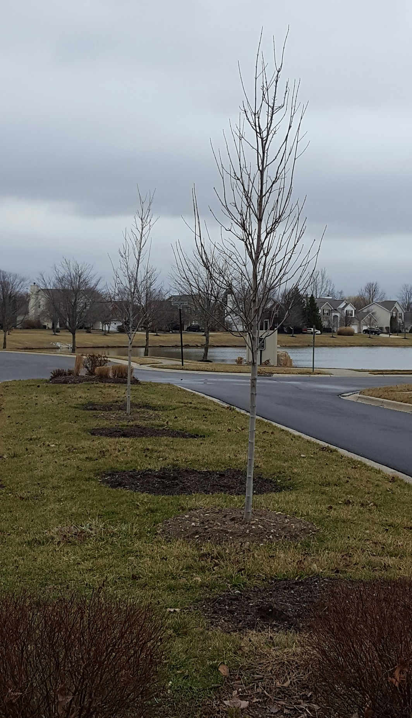
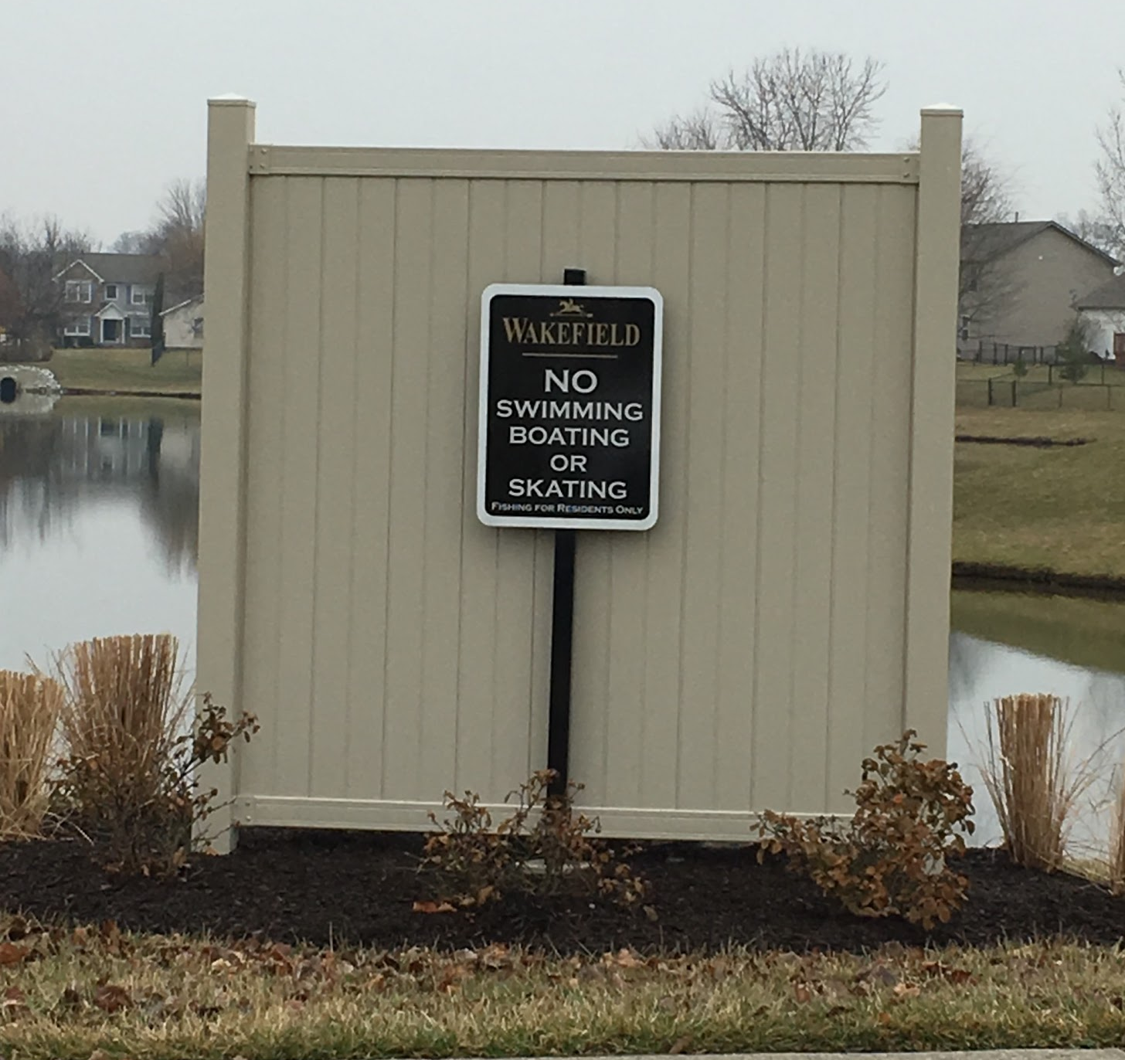
2016 Year in Review
New trees
Melanie
elanie
New panel by pond

Slide 6
State of the HOA Report
2016 HOA fees $300 / $81,900 expected income (273 homes)
  $1,350 late fees charged
  $198 bad debt written off
2016 income - $86,384 (2016 and prior year past due balances)
2016 Delinquencies - $7,651
2016 Expenses $78,951
  Lawn care / Common area $43,903
  HOA Management $12,600
  Legal Services $7,266
  Utilities (Duke, Bargersville) $6,118
  Insurance $3,076
  Pond $2,797
  Administrative $1,648
  Irrigation $830
  Community/Social $712
Treasurer - Karen Ross
Review of 2016 budget/expenses
Proposed 2017 budget
Annual Dues can be paid online now. Check the e-mail you received from Meridian. If paying by bank transfer there is no fee, pay with credit card there is a fee
Annual dues must be PHYSICALLY RECEIVED AT MERIDIAN by March 1st. (not in the mail)
As of January 1, 2017 homeowners will be responsible for the $200 fee that the HOA is charged when an issue is filed with the lawyer’s office
Funds remaining Dec 31, 2016 - $31,736 (NBI)

Slide 7
2017 Budget Revenue
Karen
HOA fees $300 / $81,900 expected income (273 homes)
  NO change from 2016
  Due on March 1, 2017, or a $25 late fee will be assessed
Bad Debt budget $2,000
  Less than $200 written off in 2016 as of Nov 2016
  Decisions made to write off debt based on cost to collect
Reserve Funding budget $3,600
  Increase from $3,000 2016
  Funds kept in reserve for future improvement projects

Slide 8
2017 Budget Expense
Karen
Lawn Care $39,720 52.1%
Mgt Fee $12,600 16.5%
Utilities $6,500 8.5%
Legal Services $5,000 6.6%
Pond Maint. $3,200 4.2%
Insurance $3,200 4.2%
Common Area Maint. $2,000 2.6%
Postage/Copies $1,400 1.8%
Irrigation $900 1.2%
Social/Community $800 1.0%
Welcome $500 0.7%
Misc Admin $480 0.6%

Slide 9
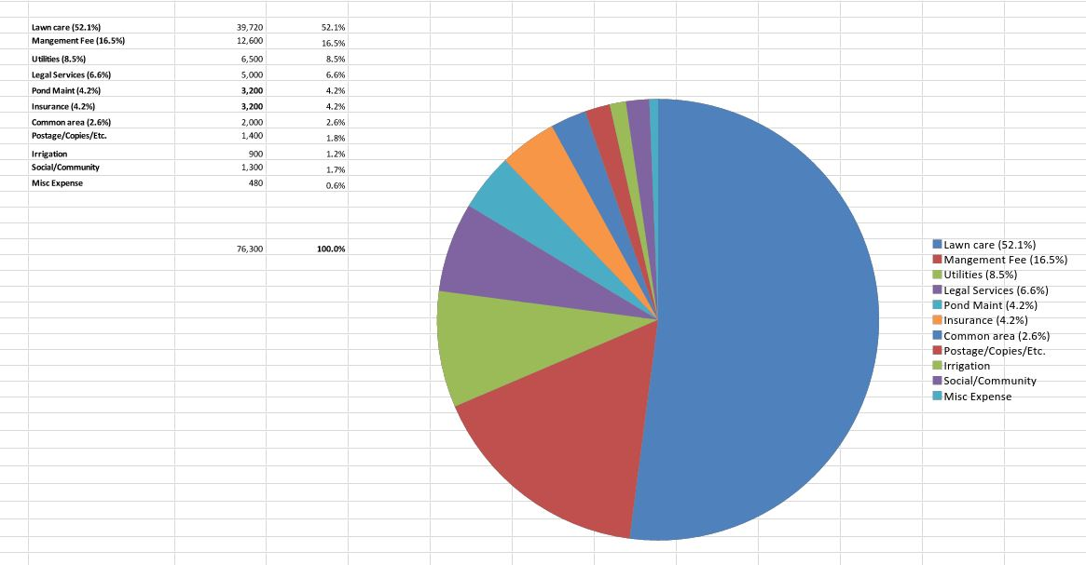
2017 Budget Expense
Karen

Slide 10
2017 Plans for Wakefield
Try to have the annual picnic
Neighborhood Yard Sale- Sat. June 17
Discuss new street signs
Discuss saving $ for lights on walking path
Need new “Welcoming Committee”
Melanie

Slide 11



Metronet
Sam
In Wakefield “Area”, Metronet has laid 15,000 of 50,000 linear feet of cable
Should be done by 3/1/17
But feeder trunks will take at least a year
Call 877-386-3876 or go to metronet.net to create a work order or sign up for service in advance

Slide 12
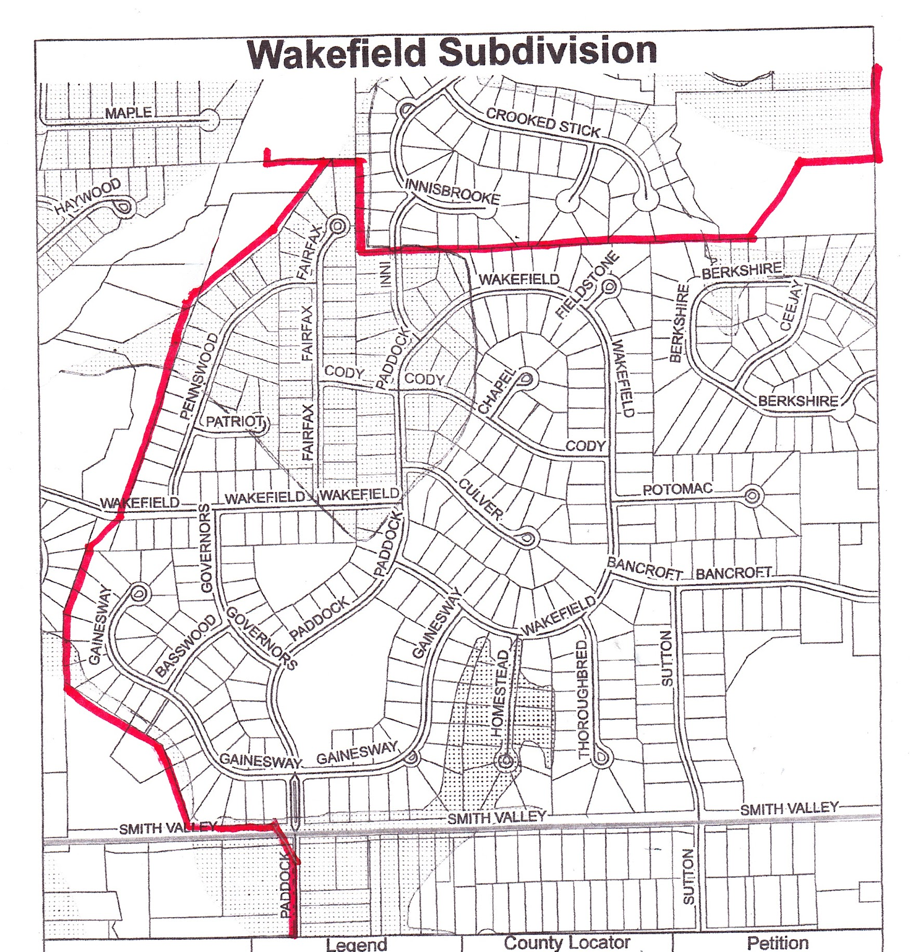
Sewer Project
Rob
60 inch piper under walking path
21 inch pipe between Wakefield/Innisbrooke/Berkshire
Affected homeowners should have received a letter
Late 2017-Early 2018 engineers meet with homeowners to discuss appraisals/replacement cost of property to be damaged
Late 2018 start construction

Slide 13
Architectural Change Request Procedures
Steve
Rules and Regulations changes are now official
Categories have been added and clarified as to what does and does NOT need approval.
Fencing Guidelines have also been updated.
All forms can be found on www.CGWakefield.com and submitted to Meridian Management via e-mail.

Slide 14

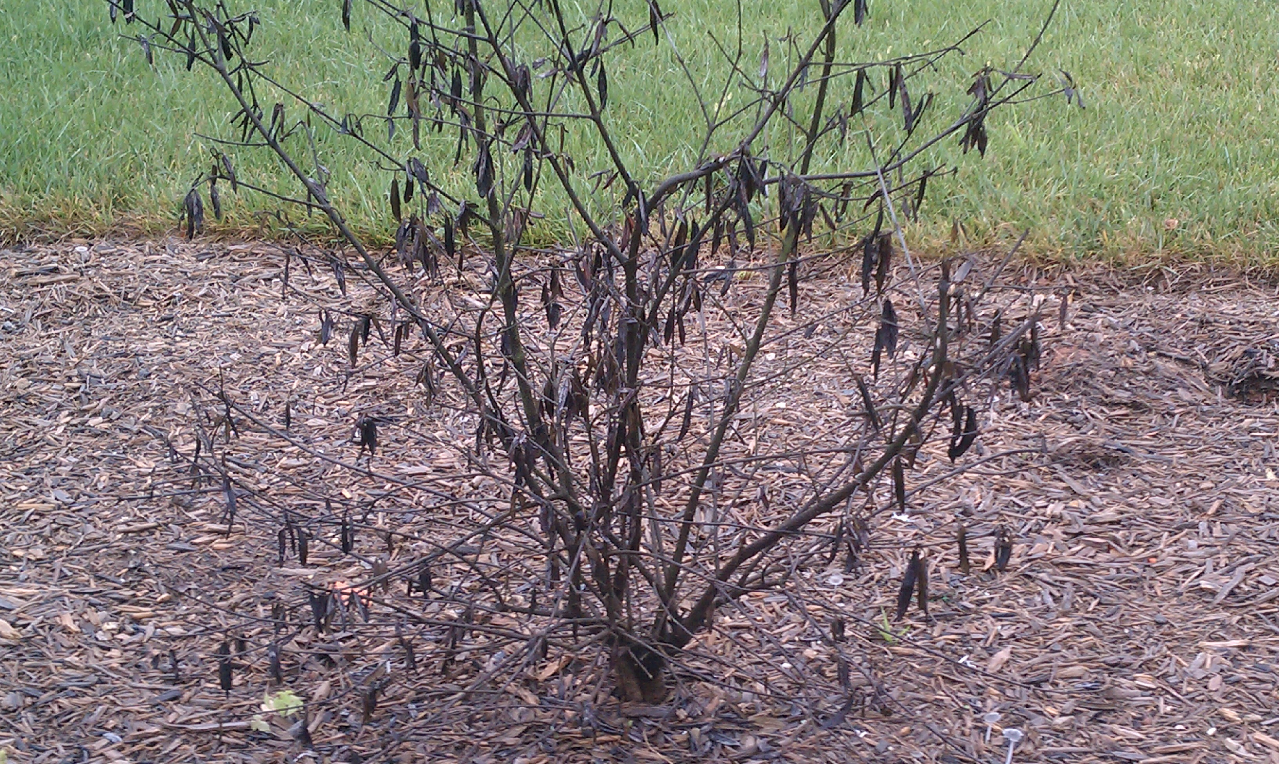
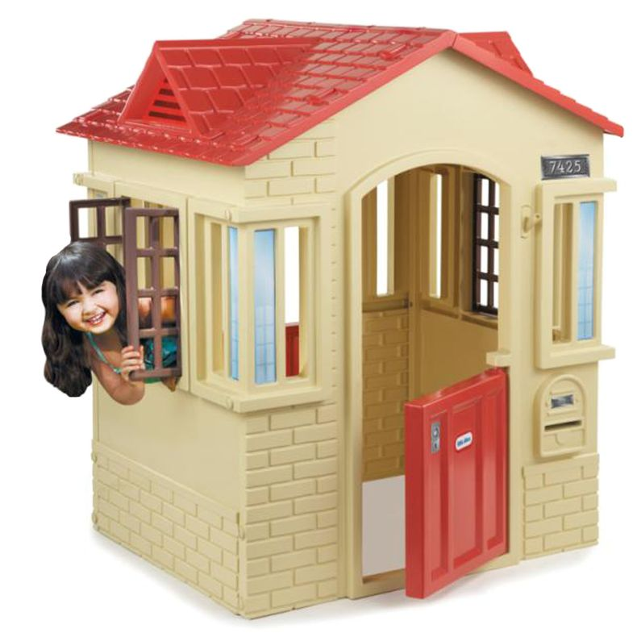
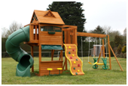
Items that no longer need approval.
Steve
Change in color scheme of house if it is on the approved color list.(www.cgwakefield.com “Architectural” tab.)
Architectural Shingles, any color that is on approved list.
Removal of dead, overgrown, or undesired plantings.
Prefabricated playsets or playhouses that fit guidelines.

Slide 15
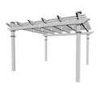
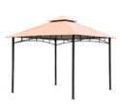
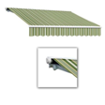
Items that no longer need approval. (ctd.)
Steve
Prefabricated pergolas
Temporary gazebos
Retractable awnings
ALL must be in backyard ONLY

Slide 16


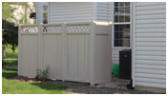
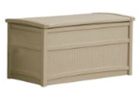
Trash & Storage
Steve
Compost bins in backyard allowed.
A partition behind house to store trash hoppers and wood piles. Must fill out an ACC request and get approval.
Deck boxes ONLY allowed

Slide 17


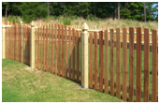

Fencing guidelines
Steve
Black chain link rules stay the same.
ALL fencing must still have ACC approval.
Pool fencing clarified, ASTM covers added.
Picket fencing:
  More styles allowed
  Vinyl allowed
  Colors-untreated wood, white, or wood colored stain.

Slide 18
Rental Restriction Amendment
Dave
Talking Points-
Lower property values- upgrades and maintenance
Lower property values-rentals “on the books”
Wakefield West passed the same
Hardship clause included to cover temporary issues
Violations- 57% of rental homes received violation letters summer 2016, 35% are repeat offenders
Violations- Only 20% of homeowners received letters, ONLY 2% were repeat offenders
Board asks that all votes be mailed to Meridian by April 30, 2017 to allow time to record, process, and file with Johnson County
Come cast your vote TONIGHT at the back table!!
124 “yes” votes have been cast. We need 182

Slide 19

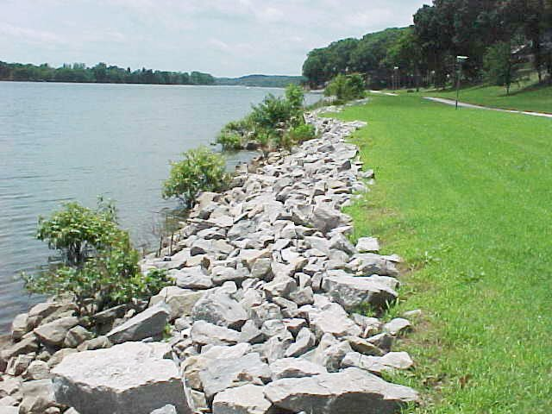

Common Courtesy Items
Remember-Board members are volunteers who care about our neighborhood. We are human and are not perfect.
Please make sure dogs are not barking during quiet hours of 11pm-6am. Please make sure dogs don’t bark for hours during the day.
Pick up all dog messes when walking your pet.
Make sure to remind kids not to throw the big ‘rip-rap’ rocks into the pond drains.
Remind kids NOT to walk on ice on the pond.
Remind kids to be respectful of the new playground. No climbing on canopy, no big kids in baby swings, no rude language or disrespect towards adults.
Facebook is a place to ask questions, share ideas, and help with safety. It is NOT to argue about covenant violations, fireworks, etc.
Kim

Slide 20
Election of New Board Members
Kim
Up for Re-election:
Kim Duffie
Karen Ross
Melanie Piper
Open position
Call for volunteers to run for the board.
One minute speech from each candidate.
Vote
Vote count by Meridian and a volunteer homeowner
Introduction of the new 2017 Board.

Slide 21
Final Thoughts
When in doubt, ALWAYS call Meridian Management. Call Sam for covenant violations, neighborhood complaints, architectural change questions, general maintenance, etc. 317-262-4989
Close the meeting
Kim

