Slide 1
Wakefield HOA
Annual Meeting - January 19, 2016

Slide 2
Current Board Members
Ron Pitcock - President
Steve Pappas - Vice President
Karen Ross - Treasurer
Angie Wall - Secretary
Melanie Piper - Member-At-Large
Kim Duffie - Member-At-Large
Rob Souchon - Member-At-Large

Slide 3


2015 Year in Review
Owner: Tom Spencer
Our Property Manager:
Sam LeStourgeon
If you ever have a question or concern, PLEASE call Sam. He and Tom are very easy to work with, very understanding, and are very professional about getting things done politely, and promptly.
New Management Company:
Meridian Management Co.
(All contact information can be found at www.cgwakefield.com under the “Resources” tab.)
Welcoming Committee Baskets-
Pam Rockwell & Lyssa Briscoe

Slide 4
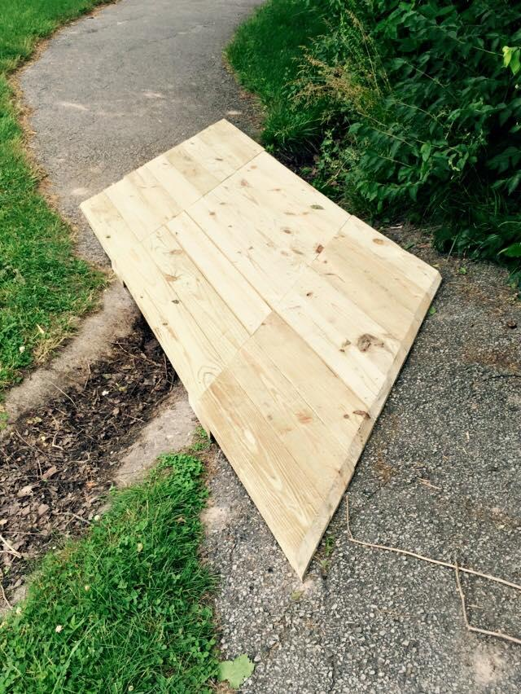
Upgrade to Potomac Park
Organized by: Melanie Piper
Bench with shade canopy
T-swings for 3yrs and under
Teeter-totter
Balance Beam
New round picnic table
Rebuild of old picnic table
Addition of new mulch up to code (Please remind older children not to climb on the baby swings or canopy. Thanks!)
New foot bridge on walking path

Slide 5
Election of New Board Members
Up for Re-election:
Steve Pappas
Angie Wall
Rob Souchon
Open position for 2016 only (re-elect Jan. 2017)
Open position for 2016-2017 (re-elect Jan. 2018)
Call for volunteers to run for the board.
One minute speech from each candidate.
Vote
Vote count by Meridian and a volunteer homeowner
Introduction of the new 2016 Board.

Slide 6
State of the HOA Report
2015 HOA fees $275 / $75,075 expected income (273 homes)
2015 income rec’d - $76, 280
2015 - Dues Receivable - $8,668
2015 Expenses $76,379 (based on actual payments)
  Lawn care $35,225
  HOA Management $9,878
  Utilities (Duke, Bargersville) $5,807
  Insurance $3,130
  Pond/Irrigation $2,674
  Legal $2,568
  Administrative $1,802
Playground upgrade $14,330
Welcome Committee $ 487
Treasurer - Karen Ross
Review of 2015 budget/expenses
Proposed 2016 budget

Slide 7
2016 Budget
HOA Dues Increase
  Constant at $275 for a number of years
  Future special projects need to be funded - walking path
  Need to keep reserve for unanticipated repairs
Highlights of 2015
  Playground improvement
  Welcome Committee, Newsletter / magnet
  Irrigation using pond water, installed in 2014 but we see the results now in reduced water utility cost
Highlights of 2016
  Dead tree removal and replacement $2,850
  Timely dues collection efforts for past due balances
2016 HOA fees $300 / $81,900 expected income (273 homes)
  Bad debt / Reserve funding
2016 Expenses $76,900
  Grounds Maint $46,572
  HOA Management $12,600
  Utilities (Duke, Bargersville) $7,400
  Insurance $3,133
  Legal $4,000
  Administrative $1,500

Slide 8
Revision of the Rules & Regulations
Kim Duffie, Steve Pappas, Karen Ross
IMPORTANT: The Rules and Regulations have NOT been finalized so please follow the original Rules & Regs and Covenants until further notice.

Slide 9
Architectural Change Request Procedures
Categories have been added and clarified as to what does and does NOT need approval.
Fencing Guidelines have also been updated.
All forms can be found on www.CGWakefield.com and submitted to Meridian Management via e-mail.

Slide 10

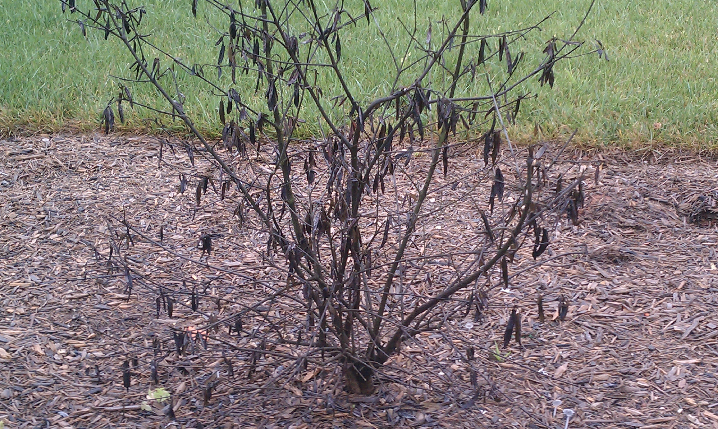
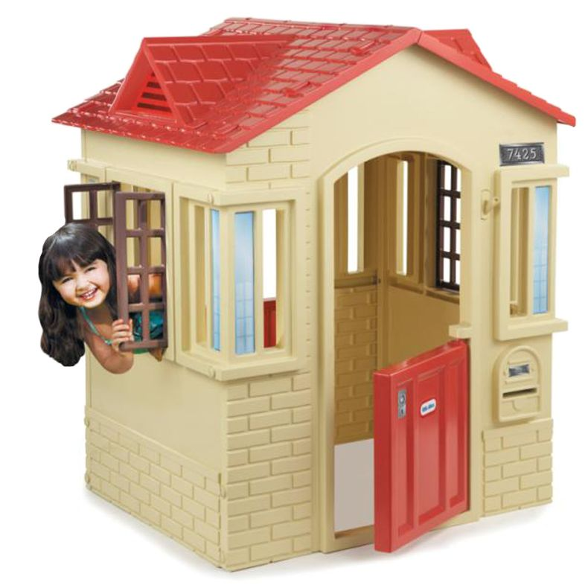
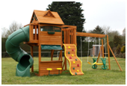
Items that no longer need approval.
Change in color scheme of house if it is on the approved color list.(www.cgwakefield.com “Architectural” tab.)
Architectural Shingles, any color that is on approved list.
Removal of dead, overgrown, or undesired plantings.
Prefabricated playsets or playhouses that fit guidelines.

Slide 11
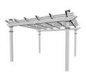
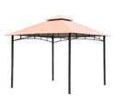
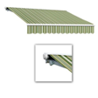
Items that no longer need approval. (ctd.)
Prefabricated pergolas
Temporary gazebos
Retractable awnings
ALL must be in backyard ONLY

Slide 12


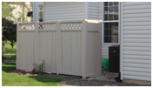
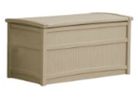
Trash & Storage
Compost bins in backyard allowed.
A partition behind house to store trash hoppers and wood piles. Must fill out an ACC request and get approval.
Deck boxes allowed

Slide 13
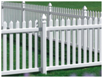
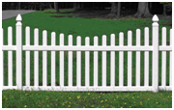
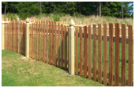
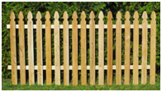
Fencing guidelines
Black chain link rules stay the same.
ALL fencing must still have ACC approval.
Pool fencing clarified, ASTM covers added.
Picket fencing:
  More styles allowed
  Vinyl allowed
  Colors-untreated wood, white, or wood colored stain.

Slide 14
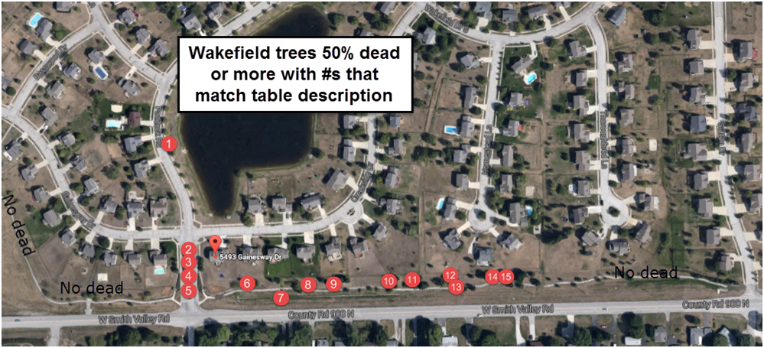
2016 Goals
Rob Souchon
Removal and replacement of dead trees
Walking Path Upgrades

Slide 15
Final Thoughts
Crime Watch Flyer
Open Floor for homeowners
When in doubt, ALWAYS call Meridian Management. Tom and Sam are very friendly and helpful!!
Close the meeting

